Slide 1
Teams Code
LECTURE: 6ij3j7d
TUTORIAL:
T1 | 2qrx5yz
T2 | 07ws5v8
T3 | x45t2o3
T4 | wpoz76v
T5 | r6r9itv

Slide 2
Computing Theory
Lecture 1: Subject Briefing & Introduction

Slide 3
Lecturer information
Lecturer Name: Ms.Farhana Illiani bt Hassan
Email: farhana.illiani@apu.edu.my
Office: School Of Computing, Block C, Level 5
Communication:
Teams chat (online)
Staff room @level 5 (physical)

Slide 4
Resources
Main Reference
Homenda, W., & Pedrycz, W. (2022). Automata Theory and Formal Languages. De Gruyter. (ISBN: 9783110752274)
Rich, E. (2019). Automata, computability and complexity : theory and applications. (ISBN:9780132288064)
Maheshwari, A., Smid, M. (2014), Introduction to Theory of Computation. Carleton University, Ottowa CA. e-book available at: http://cglab.ca/~michiel/TheoryOfComputation/TheoryOfComputation.pdf
Sipser, M. (2012). Introduction to the Theory of Computation (3rd Edition). Course Technology (ISBN: 978-1133187790)

Slide 5
Objective
1. Contribute to the achievement of the learning outcomes specified for the student’s award at Level 2.
2. Meet the prerequisite requirements of modules at Level 3 of study.
3. Provide an introduction to the study of formal models of computation.
4. Introduce and begin to develop student skills in relation to the use of automata, regular expressions, and context-free grammars.
5. Introduce and begin to develop lifelong learning skills of independent learning and study in relation to computational capabilities and their limitations.
6. Introduce students to the knowledge, skills and techniques relevant to the theory of computation and complexity studies.
7. Enable students to develop their ability to:
Critically analyze problems and understand theoretical foundations
Design solution methods and understand their limitations
Learn from varied sources

Slide 6
Learning Outcomes
Design automata and generate regular expressions for specified languages.
Design and analyse context-free grammars for specific syntactic rules.
Describe and Design Turing machines to accomplish specified computations.
Explain and discuss complexity and decidability of problems.

Slide 7
Assesment
Group Assignment :40%
Final Exam :60%

Slide 8
What is expected of you
You should abide to all the rules & regulation of APU
Proper attire.
No speaking of dialects.
Attendance is compulsory and valid medical certificates or letters from parents /guardians must support any absence from class.
Three lateness will be equal to one absence.
All pagers and handphones should be turned off during lectures.

Slide 9
RESPECT
PUNCTUAL
COMMITMENT

Slide 10
Why we need Computing Theory
To understand the nature of efficient computation
The Theory of Computation provides a new viewpoint on old phenomena.
The Theory of Computation is also concerned with finding the most efficient methods for solving specific problems.
For example, multiplying numbers can be done more efficient than via the adding the numbers repeatedly

Slide 11
https://www.youtube.com/watch?v=SV57Yv8BXBc

Slide 12
Categories in Theory of Computation
Automata theory
study of abstract machines (or more appropriately, abstract 'mathematical' machines or systems) and the computational problems that can be solved using these machines
Formal Language Theory
Language theory is a branch of mathematics concerned with describing languages as a set of operations over an alphabet.
Computability theory
Computability theory deals primarily with the question of the extent to which a problem is solvable on a computer
Computational complexity theory
Complexity theory considers not only whether a problem can be solved at all on a computer, but also how efficiently the problem can be solved.

Slide 13
Automata
Automata are concerned with the modelling of computation and specifically how we can reason about computation.
In particular,
The key role of memory is emphasized in three different approaches to memory,
being none (finite state machines), DFA & NFA
Deterministic finite Automata
NonDeterministic Finite Automata
a single stack (a pushdown automaton) and PDA
a semi-infinite tape (a Turing machine).

Slide 14
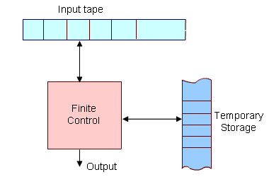
Diagrammatic representation of a generic automation.
The most important feature of the automaton is its control unit, which can be in any one of a finite number of interval states at any point. It can change state in some defined manner determined by a transition function.

Slide 15
Grammars
Grammars are concerned with the specifications of syntax rules
In everyday language, like English, we have a set of symbols (alphabet), a set of words constructed from these symbols, and a set of rules using which we can group the words to construct meaningful sentences.
A typical rule can be defined as
< sentence >< noun-phrase > < predicate >
Meaning that "a sentence can be constructed using a 'noun-phrase' followed by a predicate".
In particular,
How do you indicate to a machine what programming language constructs are legal and which are not?

Slide 16
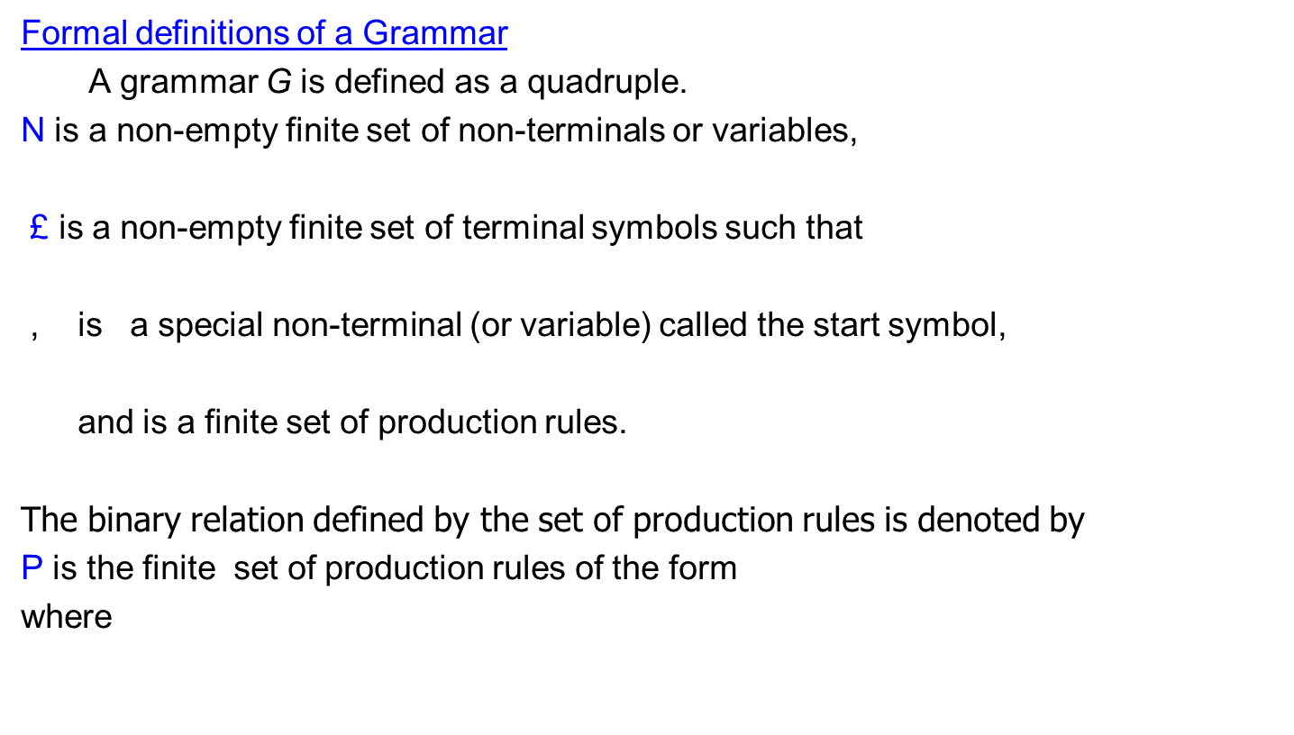
Grammars

Slide 17
Languages
A language over an alphabet ∑ is a subset of ∑*
Hence a language is just a “certain class” of strings over ∑
e.g.:
∑ = {0, 1}, L = {0, 01, 011, 0111, 01111,...}
∑ = {a,...z}, L = {ab,cd,efghi,s,z}
∑ = {0, 1}, L = { (representations of) primes}
∑ = C Tokens, L = { legal C programs }
∑ = {0, 1}, L = {strings containing at least 2 0’s}
∑ = {a,...z}, L = Ø
In general, the following format is used to specify a language:
L = {w ∈ ∑* | w has property P}
Hence to define a language, two elements needed:
building blocks / alphabets and
rules for correct sequence of letters from alphabet

Slide 18
Kleene Star /Kleene Closure
Kleene Star
Definition − The set ∑* is the infinite set of all possible strings of all possible lengths over ∑ including λ.
Representation − ∑* = ∑₀ ∪ ∑₁ ∪ ∑₂ ∪…….
Example − If ∑ = {a, b}, ∑*= {λ, a, b, aa, ab, ba, bb,………..}
Kleene Closure/Plus
Definition − The set ∑⁺ is the infinite set of all possible strings of all possible lengths over ∑ excluding λ.
Representation − ∑⁺ = ∑₀ ∪ ∑₁ ∪ ∑₂ ∪…….
∑⁺ = ∑* − { λ }
Example − If ∑ = { a, b } , ∑⁺ ={ a, b, aa, ab, ba, bb,………..}

Slide 19

Languages and Grammers
Formaly, for a given grammar
the language generated by G is

Slide 20
Computability
Computability is concerned with the fundamental limits of computation (in contrast with the resources view used in complexity).
In particular, it may be surprising to learn that there are some problems for which it can be proved that computers (at least in their current conception) cannot solve.

